Slide 1
Existing Technologies and Data Governance
Adriaan Veldhuisen
Product Manager Privacy & Security
Teradata, a Division of NCR
10 June, 2004 San Francisco, CA

Slide 2
My Assumptions for Data Governance
The Fourth Amendment forms the basis of a “right to privacy,” the right to be left alone, Justice Louis Brandeis
Everybody knows about current regulation for security and privacy: SB 1386, SOX, GLBA, HIPAA, EU DPD, …
Sensational security breaches and rising prominence of regulation do not provide input for building the right plan
Governance connotates a complex set of structures and processes, both public and private: we apply that to data
The Teradata Database allows Enterprise Data Warehousing and Analytics, and requires a Method for Data Governance
Synomos (Zero Knowledge) EPM provided Security Services Technology for Privacy protection and Data Governance at one of our customer’s implementations

Slide 3
The Role of Government: Sticks or Carrots?
Sticks
  Regulation, law and proposed penalties
  Publicity of “bad behavior” as a deterrent
  Brandishing selected bad behavior as example
Carrots
  Support standardization and certification
  Provide central threat or risk management
  Be a trusted conduit for governance information
  Facilitate sharing of data governance for professionals

Slide 4
Organization: The Key Compliance Issues
Access control: Grant access only to users with clear business reasons to access, using appropriate authentication.
Encrypted storage: Prevent access to information, external or internal, for parties that did not obtain authorization.
Post-access control: Control the actions that end users can perform with information they were authorized to view.
Role-based administration: Uniformly assign authorization to classes of users based on their organizational role.
Auditing: Be able to demonstrate, as required, who accessed the content, what actions were performed and when.
Immediate access revocation: Revoke access to information as soon as the granted access is no longer needed.

Slide 5
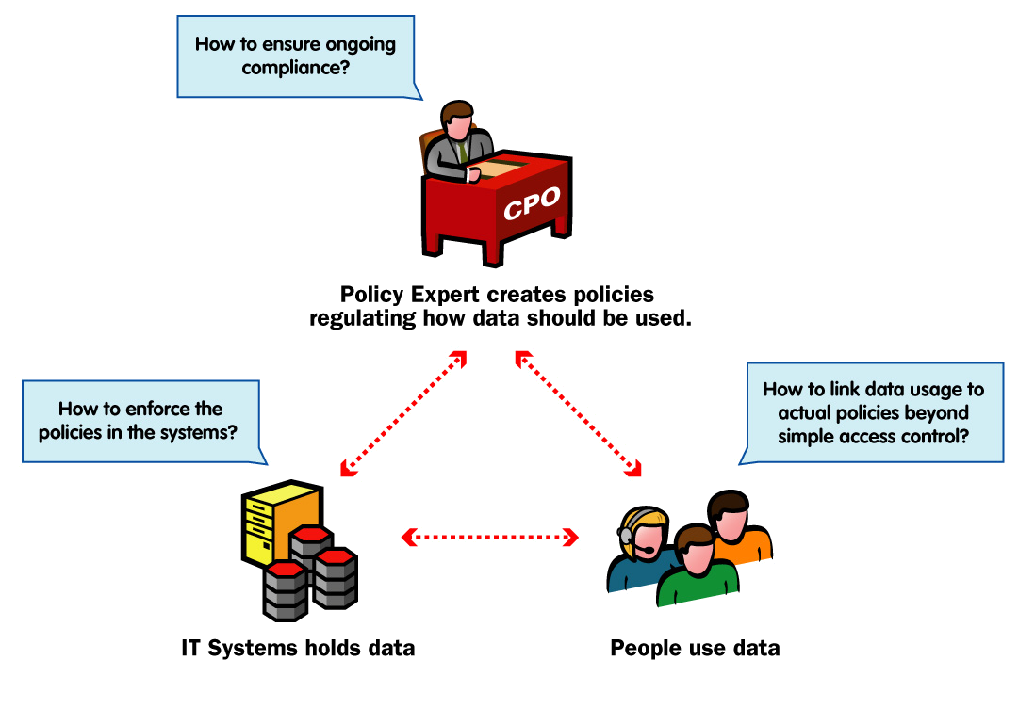
The Data Governance Challenge
Austin Hill, President - Synomos, Inc.

Slide 6
Accountability: Data Access Requirements
IT requirements for data access accountability
  be notified when someone changes database schema or permissions
  keep a record of all changes to schemas and permissions
  know what data was changed, when, and by whom
  know who has viewed certain data and when
  generate periodic reports on who accessed certain tables
  investigate suspicious behavior on certain tables
  know who modified a set of tables over a period of time
  automate procedures across multiple servers
Dr. Murray S. Mazer, Chief Technology Officer - Lumigent Technologies, Inc.

Slide 7
Accountability: Audit Requirements
A complete record of data activity requires:
  Compliance – Archival record of access to data and of schema and permissions changes
  Verification – Validate activity on data and schema
  Security – Reliable independent source of access and change history to identify responsible application and user
  Investigation – Enable damage assessment, fraud detection, and forensics
Active monitoring and alerting requires:
  Security – Reliable notification of changes to permissions, which can provide validation of proper activity or an early indication of malicious intent, violations, and vulnerabilities
  Integrity – Reliable notification of change to structure permits verification of correct implementation and rapid response to incorrect changes.
Dr. Murray S. Mazer, Chief Technology Officer - Lumigent Technologies, Inc.

Slide 8
Standards (Rules) and Procedures
Business Standards
  Procedural Business Rules (policies and procedures)
  Automated Business Rules (automated by application)
Use of the Database must be in compliance:
  Person Business Rules
  Automated Business Rules
  Case Business Rules
  Address Business Rules
  Alias Business Rules
  Person Phone Business Rules
http://dirm.state.nc.us/decs/PDF_Documents/Data_governance/

Slide 9
Durable Linkages to Procedures
DW Board
Data Governance allows focus on common data
Data Governance provides important facilitation to reunite information silos
Data Governance Team is tactically oriented versus Steering Team which is strategic
DW Steering
Team
User
Forum
Development
Team
Provide standard definitions of data
Standardize calculations
Determine quality & reconciliation
Data
Governance
Team
Doug Ebel, Director Teradata Professional Services Development

Slide 10
EDW Program Governance Structure
EDW
EDW
EDW
Executive
Executive
Executive
Board
Board
Board
EDW
EDW
EDW
Data
Data
End User
Data
End User
End User
Steering
Steering
Steering
Certification
Certification
SME Teams
Certification
SME Teams
SME Teams
Committee
Committee
Committee
Team
Team
Team
Business Alignment Team
Business Alignment Team
IT Development Team
EDW
IT Development Team
EDW
EDW
Development
Development
Development
Team
Team
-
Team
-
-
Business Requirements Specialist
Business Requirements Specialist
Business Requirements Specialist
Data Steward / Data Administrator
Data Steward / Data Administrator
-
Data Steward / Data Administrator
-
Documentation Specialist
-
Documentation Specialist
-
Documentation Specialist
-
-
-
-
-
Logical Data Modeler
Logical Data Modeler
Logical Data Modeler
Acceptance Tester
Acceptance Tester
-
Acceptance Tester
-
-
-
-
-
Metadata Administrator
Metadata Administrator
Metadata Administrator
Training Specialist
Training Specialist
-
Training Specialist
-
-
-
-
-
Query & Report Tool Specialist
Query & Report Tool Specialist
Query & Report Tool Specialist
End User Support Specialist
End User Support Specialist
-
End User Support Specialist
-
-
-
-
-
Physical Database Designer
Physical Database Designer
Project Manager
Physical Database Designer
Project Manager
Communications Specialist
Project Manager
Communications Specialist
-
Communications Specialist
-
-
-
-
-
Metadata Administrator
Metadata Administrator
Metadata Administrator
-
-
-
Help Desk Support
Help Desk Support
Help Desk Support
-
-
-
Database Administrator (DBA)
Database Administrator (DBA)
Database Administrator (DBA)
-
-
-
Extract, Transformation, Load (ETL)
Extract, Transformation, Load (ETL)
Extract, Transformation, Load (ETL)
Programmer
Programmer
Programmer
-
-
-
Systems Architect / Technical
Systems Architect / Technical
Systems Architect / Technical
Specifications Analyst
Specifications Analyst
Specifications Analyst
-
-
-
Applications Development Specialist
Applications Development Specialist
Applications Development Specialist
-
-
-
Acceptance Tester
Acceptance Tester
Acceptance Tester

Slide 11
Roles and Responsibilities
FOCUS: Culture
FOCUS: Culture
TASK: Champion change
TASK: Champion change
-
-
Drive EDW awareness & culture change within the corporation
EDW
Drive EDW awareness & culture change within the corporation
EDW
EDW
EDW
-
-
Approve funding; act as final decision
Approve funding; act as final decision
-
-
making authority
Executive
making authority
Executive
Executive
Executive
-
-
Perform financial reviews of spending against plan and results
Perform financial reviews of spending against plan and results
achieved
Board
achieved
Board
Board
Board
-
-
Establish the EDW as the “system of record” for decision
Establish the EDW as the “system of record” for decision
-
-
making
making
and enterprise performance monitoring
and enterprise performance monitoring
-
-
Resolve business policy and organizational issues
Resolve business policy and organizational issues
-
-
Participate in quarterly reviews
Participate in quarterly reviews
FOCUS: Strategy
FOCUS: Strategy
TASK: Direct, Decide, and Drive
TASK: Direct, Decide, and Drive
-
-
Drive EDW awareness and culture change within their organizatio
Drive EDW awareness and culture change within their organizatio
ns
ns
-
-
Align EDW program and enterprise strategic and tactical plans
EDW
Align EDW program and enterprise strategic and tactical plans
EDW
EDW
EDW
-
-
Identify and prioritize EDW business improvement opportunities
Identify and prioritize EDW business improvement opportunities
within their organizations
Steering
within their organizations
Steering
Steering
Steering
-
-
Support cross
Support cross
-
-
functional prioritization of EDW opportunities
Committee
functional prioritization of EDW opportunities
Committee
Committee
Committee
-
-
Recommend funding
Recommend funding
-
-
Monitor project progress; remove roadblocks
Monitor project progress; remove roadblocks
-
-
Name personnel to End User SME Teams
Name personnel to End User SME Teams
-
-
Participate in monthly EDW planning and status sessions
Participate in monthly EDW planning and status sessions
FOCUS: Tactics
FOCUS: Tactics
TASK: Implement and
TASK: Implement and
Operationalize
Operationalize
-
-
Identify new EDW opportunities
Identify new EDW opportunities
–
–
both data and applications
both data and applications
End User
End User
End User
End User
-
-
Set priorities
Set priorities
-
-
Define project scope
SME
Define project scope
SME
SME
SME
-
-
Own and define business requirements
Teams
Own and define business requirements
Teams
Teams
Teams
-
-
Help with data definitions and business rules
Help with data definitions and business rules
-
-
Validate the data and applications at milestone checkpoints
Validate the data and applications at milestone checkpoints
-
-
Act as beta testers for deliverables
Act as beta testers for deliverables
-
-
Act as spokespersons and champions
Act as spokespersons and champions

Slide 12
Building Teradata Governance Principles - 1
Implementation occurs over the development lifecycle
Plan
Plan
Plan
Analyze
Analyze
Analyze
Design
Design
Design
Build
Build
Build
Implement
Implement
Implement
Manage
Manage
Manage
EDW Strategic
EDW Strategic
EDW Strategic
EDW Strategic
Vision & Plan
Vision & Plan
Vision & Plan
Vision & Plan
Opportunity
Incremental Project Planning & Implementation
Opportunity
Opportunity
Opportunity
Incremental Project Planning & Implementation
Service Level
Service Level
Service Level
Service Level
Scoping
Scoping
Scoping
Scoping
as described in
Teradata
Solutions Methodology
Agreement
Agreement
Agreement
as described in
Teradata
Solutions Methodology
Agreement
Data Management and Certification Process
Data Management and Certification Process
Data Management and Certification Process
Data Management and Certification Process
User Support
User Support
User Support
User Support
Change Integration and Results Tracking
Change Integration and Results Tracking
Change Integration and Results Tracking
Change Integration and Results Tracking

Slide 13
Building Teradata Governance Principles - 2
Purpose of EDW Strategic Vision and Plan
  Create a strategic vision for the EDW (2-3 year planning horizon)
  Set expectations and align key stakeholders
  Establish the key operating principles
  Estimate resources, technical capabilities, investment required
  Establish the decision checkpoints and success metrics
  Manage scope and avoid technology diversions
  Secure executive sponsorship
  Elevate the importance of an EDW program at the corporate planning table

Slide 14
Building Teradata Governance Principles - 3
Purpose of Business Improvement Opportunity Scoping
  Finalize project funding for the Business Improvement Opportunity prioritized for implementation
  Understand work effort requirements for BIO development and delivery
  Establish project timeframes to ensure short, rapid delivery
  Define and secure resources
  Define success metrics
  Name a business sponsor

Slide 15
Building Teradata Governance Principles - 4
Purpose of Data Management and Certification Process
  Preserve the value of the organization’s data asset
  Instill accuracy, consistency, and confidence in data driven decisions
  Promote sharing of data across the enterprise
  Provide flexibility for business change, analytics, and decision making
  Reduce lead times for systems and applications development
  Improve data quality
  Establish and document corporate policies and standards for data definitions, business rules, data security, and change management

Slide 16
Building Teradata Governance Principles - 5
Purpose of Service Level Agreement
  Ensure EDW meets user expectations for quality, availability, usefulness, and query performance.
Purpose of User Support
  Actively engage users as stakeholders in the EDW program
  Ensure adoption of EDW
  Build champions for EDW program
  Develop user skills as knowledge workers
  Share successes and overcome roadblocks
  Create a continuous learning environment to improve business analysis and action planning
  Identify new business opportunities for the EDW

Slide 17
Building Teradata Governance Principles - 6
Purpose of Change Integration and Results Tracking
  Identify non-technical changes resulting from EDW implementation – organizational structure, policies and procedures, culture, processes, and discoveries about the business
  Establish a process to coordinate and implement change actions
  Position users for ownership, leadership, and management of the DW program
  Ensure enterprise-wide stakeholders buy-in through involvement, knowledge transfer, and issue resolution
  Create a sustainable EDW program that evolves in sophistication
  Continuously assess EDW program value and financial contribution

Slide 18
Case Study: Synomos, Teradata and RBC 1
Large financial institution (50,000 employees +) w/ multi-national operations in many lines of business
  Experienced privacy team with many interactions, committees and initiatives underway.
Compliance Pain Points
  CPO office overloaded with requests regarding use of customer data
  CPO office had limited visibility into actual uses of data in IT office
  Regular internal and external audits became too costly and time consuming so gaps grew between policy and actual practice
  Changing IT landscape and business uses of data caused large gaps between stated policies and actual practice
  Staff either interacted with an overloaded CPO department attempting to verify data use OR made assumptions &/or bypassed policy dept.
  Increased attempts to audit, enforce or monitor policy would require substantially more human resources and more time from division data stewards
Synomos, Austin Hill: Effective Privacy Management Technologies

Slide 19
Case Study: Synomos, Teradata and RBC 2
Deployment of EPM Suite (Policy Management, Web self help policy system & Policy monitoring modules and Enforcement module with customer data warehouse)
Operational Results
  Can automatically and easily manage requests coming form all departments while ensuring that they remain compliant at all times.
  Access to data is linked to a purpose & rules and is automatically enforced by EPM, compliance can be demonstrated and liability minimized.
  Solution dramatically increased the efficiency and visibility of the privacy office while educating organization on privacy policies.
  Marketing initiatives can be initiated much faster by minimizing manual policy verification.
  Internal monitoring reports are created daily showing potential risks.
  External audits can now be performed once a year at much lower cost since existing reports & data are only being verified vs. entire lifecycle being created.
Synomos, Austin Hill: Effective Privacy Management Technologies

Slide 20






Case Study: Synomos, Teradata and RBC 3
>>
SQL events risk
Publish elements
,
>>
Create and
m
anage
analysis
policy
>>
elements
>>
Reports preparation
Create and manage
>>
Monitoring triggers
`
>>
governance rules
set
-
up
Load imported
Policy rules analysis
>>
Active view
elements
,
access
-
based
to
all
policies
Align
Policy
Console
Align DGM Server
enforcement
A
c
c
e
s
s
t
o
r
e
p
o
Manage enforcement views
C
r
t
s
,
p
o
o
l
l
a
b
o
l
i
c
y
r
a
t
i
o
n
,
r
e
q
u
e
>>
Web
-
based interface
,
>>
Supports customer
s
t
s
>>
s
s
Customer Data
Customized
t
t
n
l
Warehouse
data warehouse
e
u
dashboard reports
m
s
.
e
e
environment
l
r
>>
View policy and
e
g
>>
View
-
based policy
d
n
i
e
r
submit new access
t
o
r
t
enforcement
o
i
p
n
requests
m
o
I
m
Teradata
Align Collaboration
>>
Collaboration
Environment
Module
between users and
DGM
Data elements import
,
SQL event
Align™:
A comprehensive suite of tools for automating data policy management, enforcement and monitoring across the enterprise to assure the value of enterprise data assets.
monitoring
,
access logs
>>
Import data elements
>>
into DGM server
Non
-
intrusive
Align Governance Agent
monitoring of SQL
for Teradata
events

